Slide 1

Concept

Slide 2
CUSTOMER NAME
Devu Tools
PROJECT
YXA
PART NAME
Guard_Assy.RR Fender_Splash_R
PART NO.
77250-58Q00
TYPE
Checking Fixture
DATE
22-12-2024

Slide 3
Part Images
A Surface
B Surface

Slide 4

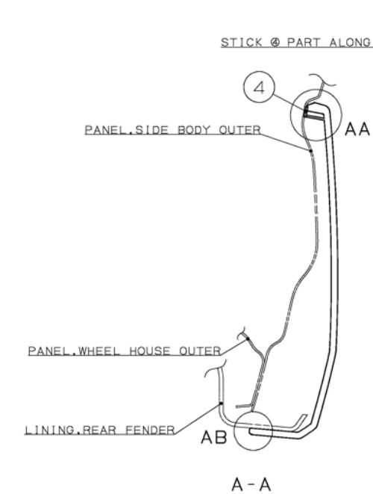
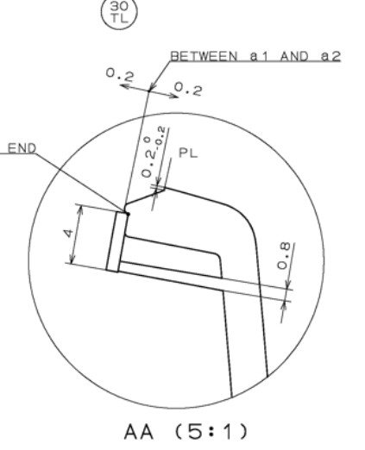
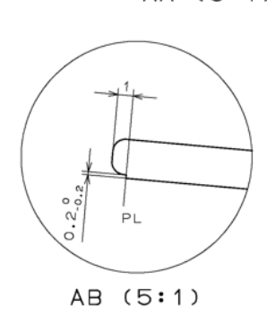
Gap Trimline
A-A
A
3
Part
A
Base Plate
Body
3
Body will be provided with 3mm gap and 0,3 mm trimline all around the as shown above

Slide 5
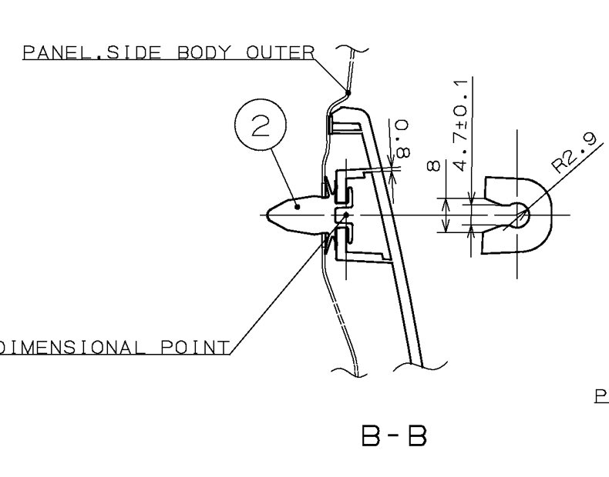
Locking and Resting
B-B
B
Mechanism
B
Part
Base Plate
Clutch Operated Mechanism will be provided as per surrounding at 01 place to lock the part as shown above

Slide 6
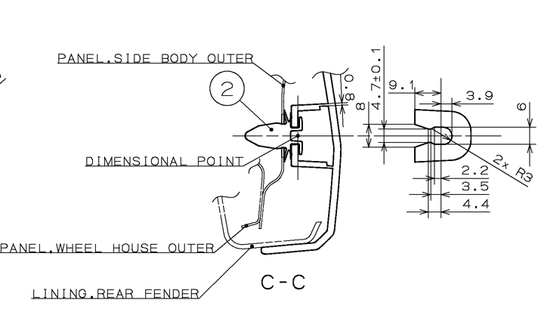
Locking and Resting
C-C
Mechanism
C
Part
C
Base Plate
Clutch Operated Mechanism will be provided as per surrounding at 01 place to lock the part as shown above

Slide 7
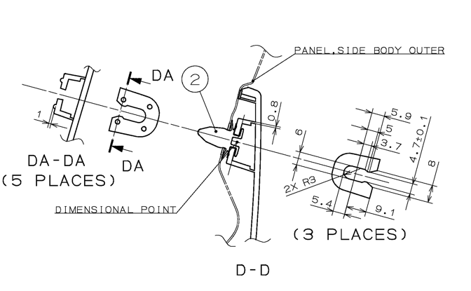
Locking and Resting
D-D
D
Mechanism
D
Part
Base Plate
Clutch Operated Mechanism will be provided as per surrounding at 01 place to lock the part as shown above

Slide 8
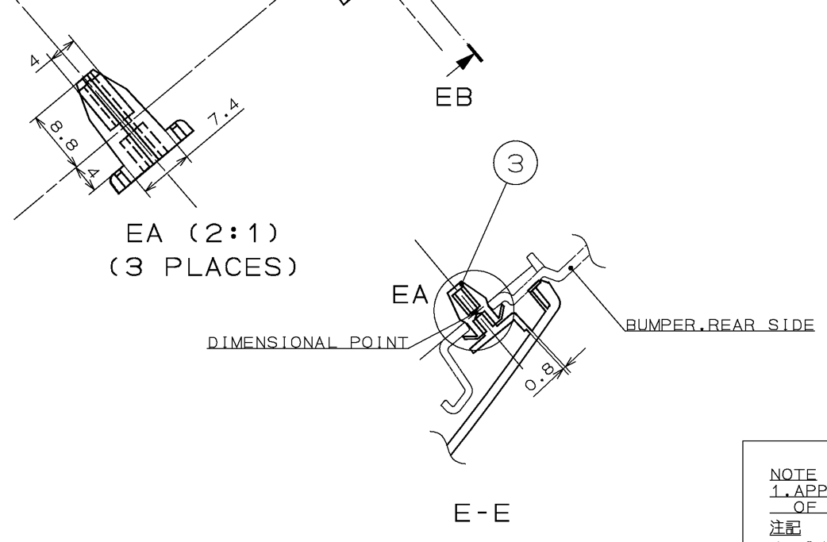
Locking and Resting
E-E
Mechanism
E
Part
E
Base Plate
Clutch Operated Mechanism will be provided as per surrounding at 01 place to lock the part as shown above

Slide 9
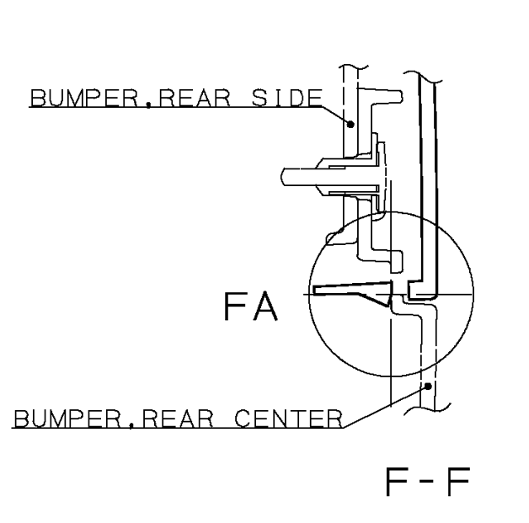
Locking
F-F
Mechanism
Part
F
F
Base Plate
Clutch Operated one side locking Mechanism will be provided as per surrounding at 02 place to lock the part as shown above

Slide 10

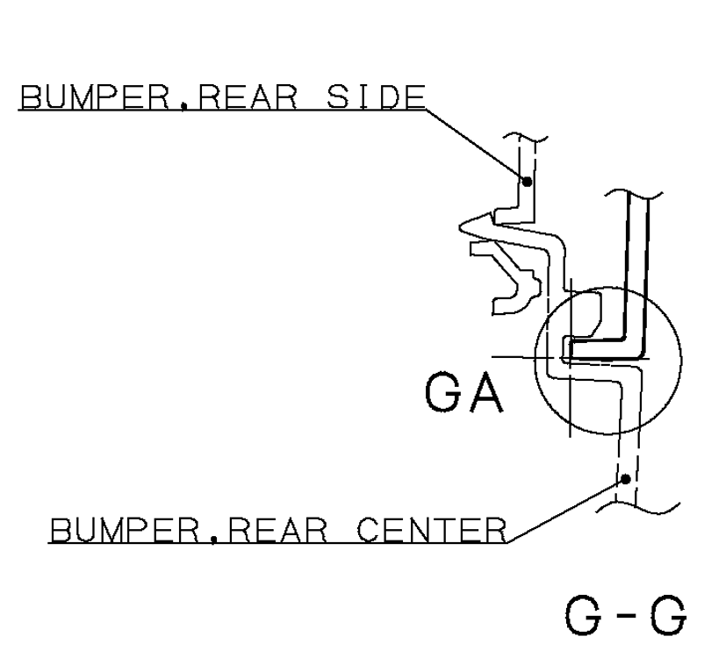
Locking and Resting
G-G
Part
Resting
G
G
Base Plate
Tongue and grove will be provided as per surrounding to rest and rock the part in respective axis as show above.

Slide 11
Gap Flush Body
H-H
Base Plate
Part
H
3
H
0
Body will be provided with 3mm gap and 0 mm flush all around the part as shown above

Slide 12
Gap Flush Body
I-I
I
Stand
Lock Pin
I
0
3
Base Plate
Part
Removable Template will be provided with 3mm gap and 0 mm flush as shown above.

Slide 13
Fixture Orientation
Isometric
Top
Front
Side

Slide 14
Thank You

